Slide 1
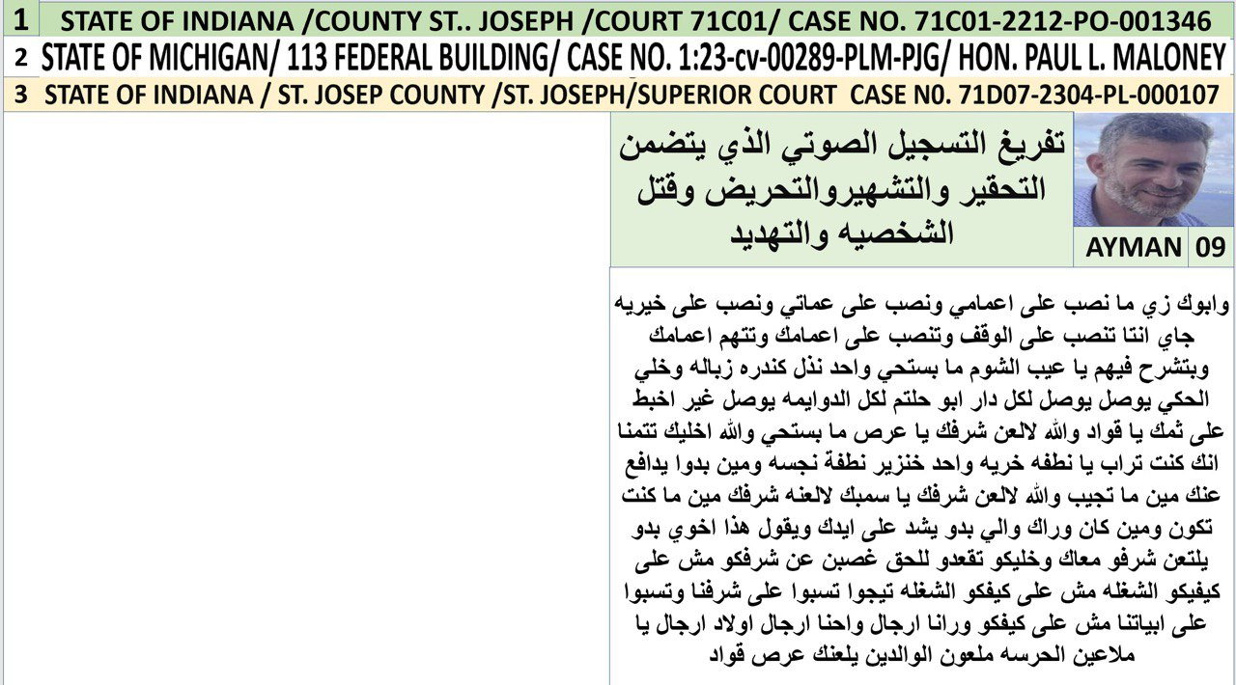



File#
1
لسماع الصوت بالعريبه اضغط هنا
TO LISTEN TO THE VOICE IN ENGLISHl PRESS HEAR
Your tongue is sinking stool, from your mouth. Your mouth is full of stool, like a tank of stool inside your stomach. You need to get it out. You are a failed person. You are envious. You envied everyone from Abu-Haltam family. You are looking at whatever everyone possesses. You were looking for anyone in America and your eyes are always on their possessions. You envied my uncle’s wife because she was shopping at the oasis. You came to I don’t know who and asked why are you shopping more than me. So and so went to Disneyland and I did’nt and so I felt frustrated because I was thrown into the ghetto of wehdat. Next to the gypsy um soltan Nouria, day and night. And my uncle went to Disneyland for a vacation, him and his children. And the other guy lives in Shmesani, and Shmesani was for you a strange land, the dream land for you because you are always in the ghetto of wehdat. And you head is full of urine and rotten during the narrow roads. Or you are without shoes. Or your pants are torn.
1- السانك هذا الذي يقطر خرى زي ثمك هذا ثمك المليان خرى وتنك النضح اللي جواتك بدك اتطلعو علينا لانك انسان فاشل حاسدنا انت لحاسود انت حاسدت كل واحد في دار ابو حلتم اتطلعت على الي بيدوا وحسدته اطلعت على الي بايد اميركا جيت على عمي طه مرته تتسوق في الواحه اجيت على ابصر مين هاذا ليش بصرف اكثر منا هذا راح على دزني لاند انا ظليتني مقهور مرمي في الوحدات عند ام سلطان النوريه انا انا طول انهاري اتصبح واتمسى بوجه ام سلطان وعمي داير على دزني لاند بشم الهوا هوه واولاده جيت وهظاك عايش في الشميساني الي كانت بالنسبه اليك كانت الشميساني بلاد غريبه ارض الاحلام بالنسبه الك لانك انتا طول عمرك بحواري الوحدات وراسك مليان ريحة صناين وخماج داير بهلزقاق يا اما حافي يا اما بنطلونك امزع

Slide 2
File#
2
Date and time of record
لسماع الصوت بالعريبه اضغط هنا
And through witness I was speaking with my close friend which lives in Michigan, close to Ismail. He is a mutual friend between me and Ismail. I asked him, what is his situation. He said, he is in a bad shape, and he doesn’t know what he is doing. He is in a very bad shape. I asked how, can you explain to me. He said, he doesn’t do anything, he doesn’t even have any transactions. He hardly sees any customers, only from far away. He only sees the customers as they enter and leave other stores, and his store is in a hidden corner. The mall threw him away there, nobody even reaches there, not even the employees which the clean the mall reach him. And he sits like a sad guy, and he thinks he just opened the store. And he doesn’t even understand how to run the store in the mall. Maybe he doesn’t even pay rent, they forgive him for the rent because he doesn’t do any transactions, because he is a failed person. You said, you opened a store in just two months loser.
وشهادة حق اقولها بحكي مع واحد صديق لي في متشغان عند ساكن جنبه بعرفه (وميتشيول فرند) بيني وبينه اني بقله شو وضعه بقلي وضعه منتهيي منتهي بقاحص ماكل روح الخل بقله كيف بقلي بطقش ولا تقه ولا برن رنه يا دوب يا دوب شوف الزبون من بعيد بس بشوف الزباين وهمه داخلين طالعين على المحلات الثانيه محله بقرنه في هالمول زاتينه ولا حدا بوصلها حتى عمال النظافه بوصلوش عنده وقاعد زي الحزين وعامل حاله انه فاتح محل و و هوه لا يفقه في المحل شيئا ول والمول بجوز بدفعلوش اجار مسامحينه في الاجار لانه بطقش ولا تقه يا فاشل فتحت محل بشهرين بشهرين يا فاشل

Slide 3
File#
3
Date and time of record
لسماع الصوت بالعريبه اضغط هنا
Because you are envious because you look at Mustafa's house, him selling plants. So you want to copy cat him because you envy him. And you are looking at people’s money. You were entering my uncle omar’s store and you stole their customers and you grab him from his hands and you tell the customers come with me, I have better batteries than this man. And you go to every single person envying them and trying to copy them. Even the children of my Aunt Siham come and sell in front of your store and you kicked them out telling them you need to make business here. Also you said: So and so said about so and so he is my enemy, you are the real enemy. The enemy knows himself, because you need to spread evil, you are a troublemaker, a liar, deceiving, worthless and all characteristics of evil belong to you so, you are a cursed satan. You previously had an idol and thank God, your idol was destroyed.
لانك حسود لانك بتطلع على دار مصطفى باع زريعه بسط زريعه مصطفى بدنا انروح انبسط بزريعه زيه كنت تدخل على محل عمي عمر بتسرق الزبون من ايدوه وتجيبو وتقله تعال تعال اطلع معي تعال انا عندي بطاريه احسن من بطاريات هذا الزلمه كنت اتروح على مين ما كان يكون يشتغل اولاد اولاد سهام اجو يبسطو قدامك طريتهم اتبسطوش عنا اتبسطوش عنا بعدين بتقول بتقول عن فلان قال عن فلان عدوي انتا عدوي متدخلش والله العكس صحيح الي قال عدوي هو عارف حاله قال انتا عدوي لانك انتا خبيث بدك توقع الناس ببعض فساد وفتان وكذاب ومدلس ونجس وحقير وكل الصفات الشيطانيه موجوده فيك فانتا شيطان رجيم كان في الك صنم والحمد لله رب العالمين صنمك انهدم

Slide 4
File#
4
Date and time of record
لسماع الصوت بالعريبه اضغط هنا
Oh brothers, my cousins, my beloveds, people of Abu-Haltam the honorable. I announce to you publicly this idol his name is Ismail, he was a big thing in the sight of people. We already brought him down and damaged him successfully, and the power is from God and the honor of our leaders, especially from our main leader, may God bless his age, he supported us with power to destroy this idol, the liars are failures, and his name is Ismail. He was deceiving the people when they thought he was something great. In the reality he is a cochroach, not worth any penny in the market of the hero, or when the market is high. Nobody accepts giving him even a penny, this is your idol guys, they made him their master lord, we destroyed him, enough we demolished you, you are demolished. You have gone bankrupt. You have nothing other than going to the people and saying sorry.
يا اخوان يا اولاد عمي يا حبايبي يا ال ابو حلتم الكرام اعلنها لكم على الملئ هذا الصنم الي اسموه اسماعيل وكان اشي كبير بعين الناس تم اسقاطه وتحطيمه بنجاح باهر والقوه كانت من الله ومن ساداتنا من حضرة سيدنا امدنا الله امد الله بعمره انه هوه الي امدنا بقوه عشان انحطم هذا الصنم الكاذب الفاشل الي اسمه اسماعيل الي كانت الناس مخدوعه فيه ومفكريته اشي عظيم وهوه طلع صرصار لا بسوى ولا ولانقله بسوق الزلم بسوق الغلى ما بجيب قرش هيه هاذا صنمهم ربهم الاعلى حطمناك حطمناك خلص انتهيت انتى انتهيت انتا افلست ما ظل عندك اشي الا تطلع على الناس تعتذر

Slide 5
File#
5
Date and time of record
لسماع الصوت بالعريبه اضغط هنا
Look, Look to him, how his method to deceive and lie oh crowd, look how he deceives the people and lies to them. He said my father came to me in a dream and he visited the graveyard of his father and he spoke with his father in the grave and he said look my father, you destroyed us because you did not ask for your rights. He lied and deceived the people and he said my father came in a dream and he said to one of our brothers, Ismail has authority of us, as in Ismail has power of attorney to take action instead of me. My authority?! I swear you are cursed, I don’t want to use foul language right now. You hide the truth. Man you change the truth and you are impure and despised. And you are a liar, you abused your father and you abuse the feeling of people. He said here I am, next to my father, next to him in the grave, then in his grave, I remember when I was telling you my uncle, he is sitting in Jannah, he is very happy, leave him alone, you told me, No! My father, he is in paradise, but he is sad. You think he is sad? You are ignorant, you don’t know anything in the religion. Your father is sad in Jannah, I swear to God you are broke! I swear to the Great God that you have become bankrupt. And if you do not need to enter your house, you said that, don’t come to my house, and don’t enter my house, and don’t see me, and don’t see you. We swear to God, we don’t need you and we don’t need 60 like you, you are an idol and you’ve been destroyed. The people were putting you in a high place and they thought you were something. However we have exposed you and we let everyone know you are a deceiver and impure and dirty. We let everyone know your reality.
شوفو شوفو كيف طريقة التدليس والكذب يا شباب شوفو كيف بدلس على الناس وبكذب عليهم بقول ابوي اجاني بالرؤيا ورايح عند قبر ابوه عشان يقوله يابا شايف كيف انتا دمرتنا لانك ما طالبت بحقنا بكذب بدلس عالناس بقلهم قال ابوي جايني بالرؤيا وقال لواحد من اخواننا انا وكيلي اسماعيل انا وكيلي قال ايش اسماعيل والله انك لعين يا يا بديش اسب هسا على شسمو انتا يا زلمه مدلس ونجس وحقير وكذاب واستغليت ابوك وبتستغل عواطف الناس قال هيني عند ابوي عندو في القبر عندو في القبر بتذكر لما كنت اقلك عمي قاعد بالجنه مبسوط سيبك منه قلتلي ابوي لاء ابوي قاعد في الجنه حزين ابوي حزين في الجنه لانك جاهل بتعرفش في الدين اشي ابوك حزين في الجنه انتا والله انك مفلس اقسم بالله العظيم انك افلست بعدين ما بدك ندخل دارك هيك بتحكي لا تدخلوا داري ولا تدخلو عليا ولا تشوفوني ولا نشوفك والله بالناقص منك ومن ستين زيك انتا صنم وتحطم كان لناس عاملين مفكرينك اشي واكتشفوا اشي جديد احنا عريناك يا مدلس يا نجس يا قذر احنا عرناك

Slide 6
File#
6
Date and time of record
لسماع الصوت بالعريبه اضغط هنا
Anyone that needs to support Ismail, we will never support him to get his rights buddies. Anyone needs to support Ismail, we will never support him whether he is right or wrong. Get out of our faces and go seek support from Ismail, he will support you. You will not belong to us, I will never support anyone walking with the wrong person. Nobody force me to support one who is on the wrong path in order for me to get his rights
اي واحد بدو يوقف مع اسماعيل ما بنمشي بحقه يا حبيبي اي واحد بدو يوقف مع اسماعيل ما بنمشيله لا بحق ولا بباطل يروح يحل عنا ويخلي اسماعيل ينفعه ما النا دخل ما بطالب بحق واحد ماشي مع الباطل مش مجبور انا امشي مع واحد ماشي مع الباطل اروح اطالبلنه بحقه

Slide 7
File#
7
Date and time of record
لسماع الصوت بالعريبه اضغط هنا
Ismail uses them like a hanger, uses them like a hanger. He will never give them right or wrong. When he gives you a dollar, two dollors. Brothers, he gave me $2 for a telephone card (Alo) which he recorded as a debt and he said he wants two dollars. Ismail never gives anyone anything he just uses people.
اسماعيل مستعملهم شماعه ب ب مستعملهم شماعه لا يعطيهم لا حق ولا باطل اسماعيل لما يعطيك دولار دولارين يا اخوان دولارين بطاقة الو سجلهن علي قال بدي منك دولارين سجل علي بطاقة الو حقها دولارين اسماعيل ما بعطي حدا ما بعطي حدا اسماعيل مستعملهم اسماعيل مستعملكم

Slide 8
File#
8
Date and time of record
لسماع الصوت بالعريبه اضغط هنا
My buddies, God bless you, if they have right, go to Ismail, he will give it to him. You need from me, to become my enemy and then I go with you to give you your right. I swear to God, you are not right in that. I will never go with anybody for his rights when he is my enemy. You are against my will, and you need me to go with you and ask for your rights? I will never go with you to ask for your rights. You are against my will, so go by yourself and ask yourself to reach your right. I will support whoever is with my belief. I help those who walk with me. And I will support according to my judgement and what I believe is right. I will get my rights from those who walk with me and those I see. I told my Aunt Nawal if you see that you have the right in Alyaduda land, go with the group of Ismail. Go with the group of Ismail. But if you give up your rights and you said I will not recognize, I will not recognize, I will not recognize Alyaduda as my land. I will not recognize Alyaduda, in that time if you say that I will go personally grab your rights from all my uncles and I will stand next to their heads day and night until they give you your right. But the land, my Dad never gave it as a gift, he gave it to her because she fell into injustice. Because she was afflicted with injustice, so my father did not give it as a gift. If your father gave her money as a gift, no, the reality is that it is not a gift. If your father gave her money from his work, this the company's money. Don't say, if he said it's a gift, he should give it from his share. But if he gave it from his share of the company's money, this is another story. But the reality is that it was not gift, 'master'! The son of my Aunt Siham, they took their rights completely and my father; he did his part with them 100%. And your father also did his part. Don't say gift, NO! God bless you my uncle, let your father go publicily and say that it is a gift or It is not a gift. Even let my father say publicly mention whether he had given a gift or not.
يا حبيبي الله يرضى عليك اذا في الهم حق يروحوا يطالبوا فيه عند اسماعيل اما انا بدك اتعاديني امشيلك مع وامشي معك بموضوع حقك لا واله ما احزرت انا ما بمشي لاي انسان في حقه وهوه معاديني انتا معاديني بدك امشي معك بحقك ما بمشي معك بحقك واجيبلك حقك وانت معاديني روح طالب بحقك انتا انا بطالب بالي يمشي معي ويلي بطالب بالي بشوفه وقلت لعمتي نوال قلتلها اذا انتي شايفه انه في الك حق في ارض اليادوده روحي مع جماعة اسماعيل روحي مع جماعة اسماعيل اما اذا بتتنازلي وبتقولي انا ما بعترف انا ما بعترف باليادوده ما بعترف باليادوده ساعيتها انا بروح وبجيبلك حقك من كول اعمامي وبظلني انوق فوق روسهم ليل مع انهار لمان يعطوكي حقك اما الارض الي اعطاها ابوي معطاهاش هديه اعطاها اياها لانها انظلمت لانها كانت مظلومه مش هديه واذا ابوك اعطاها المصاري هديه لامش من هديه واذا ابوك اعطاها المصاري من شغله كان من شغل الشركه لا تحكي اذا هو قال انا هديه يعطيها من حصته هديه اه هذا اشي ثاني هاي مش هدايا يا معلم اولاد عمتي سهام اخذوا ثالث ومثلث وابوي ما قصر معهم نهائيا وابوك ما قصر معهم فلا تحكي هدايا لا الله يرضى عليك خلي ابوك يطلع يقول انها هديه او مش هديه او ابوي يطلع يقول انا اعطيتهم هديه او مش هديه

Slide 9
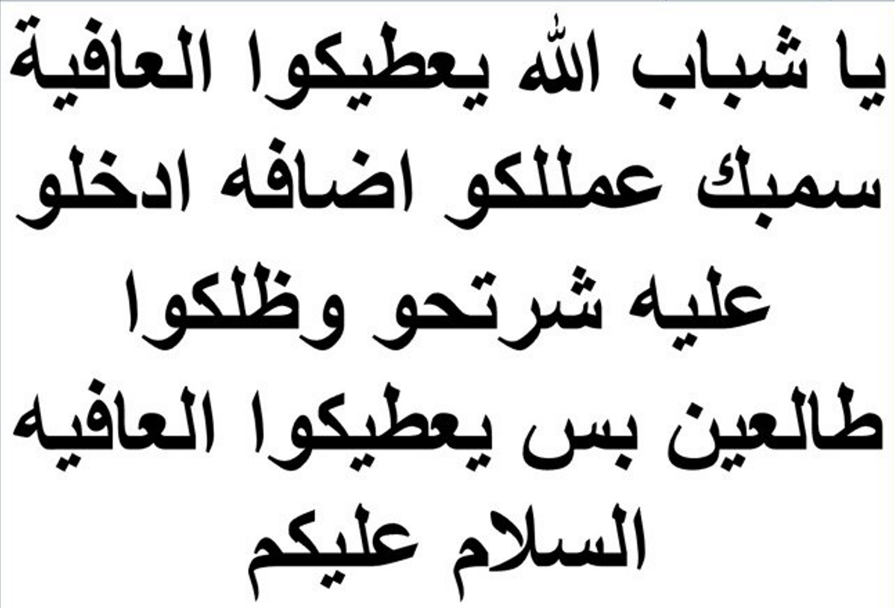
File#
9
Date and time of record
لسماع الصوت بالعريبه اضغط هنا
Hey buddies, God bless you. Sumbuk, added you to this group. Go to his group and defame him and get out, that's it. God bless you, Peace be upon you
يا شباب الله يعطيكوا العافيه سمبك عمللكوا اضافه ادخلوا عليه وشرتحوا وظلكوا طالعين بس يعطيكوا العافيه السلام عليكم
A

Slide 10
File#
10
Date and time of record
لسماع الصوت بالعريبه اضغط هنا
My master Bassam, hey buddies, God Bless you and bless your ages. We have defamed him and I was putting his voice recordings in order to defame him from his own words. From your mouth, we proved that you are wrong and we made him like an idiot. Putting videos to represent himself and talk about himself so we and uncover his weakness to the people. And we uncover his private business publicily and defame him. And whatever we planned, it happened guys. So that's the end Ismail, your job is finished, we demolished you. You are now listening to us and we will never listen to you. Your job is over and our messaged has been reached by everyone. And your idol has been destroyed successfully, very successfully. Also from your stupidity and your deception and your lies, we have exposed you to everyone.
يا سيدي بسام يا شباب الله يرضى عليكو ويطول اعماركو احنا عريناه وكان وكنا انزل تسجيلات اله عشان انعريه اندينه من فمك ندينك من فمك ندينك وخلناه زي لهبل ينزل فيديوهات عن حاله عشان نكشف عورته لناس ونكشفت عورته لناس وانفضح او او الي بدنا اياه صار والي بدنا اياه صار يا شباب فخلص انتهت مهمتك يا اسماعيل انتا هسا بتسمعنا واحنا ما بنسمعلك مهمتك انتهت ووصلنا الرساله للجميع صنمك تم تحطيمه بنجاح وبنجاح باهر كمان من هبلك وتدليسك وكذبك كشفناك

Slide 11
File#
11
Date and time of record
لسماع الصوت بالعريبه اضغط هنا
By God's will he will keep barking until he gets a difficult Corona that hits him so hard or gets a rotten death and we get rid of him and relax. A dirty dog.
ان شاء الله بتجيه بيظلو يعوي لما تجيه لفحة كورونا اتطسه تشمطه كمان لفحه واو ويفطس ويريحنا كلب اجرب

Slide 12
File#
12
Date and time of record
لسماع الصوت بالعريبه اضغط هنا
My aunt, everyone that says he is a Sufi, is a real Sufi? Look at Ismail, he made a joke about our preacher Abdul Raouf. Didn't he say the joke of religious men. About one man which lost his money, he said 'Oh my lord do not let the money fall in the hands of a religious man, because he will find a religious excuse to keep the money'. What's wrong you, are we joking with each other here? Or does he simply claim Sufism; and he lied and said that he is a following the instructions of our spiritual leader. And he has a messenger which is a neighbor of the mosque which was sending messages to Shaykh Abdul Raouf. His word doesn't make sense if anyone sensible hears it, my aunt. Send your peace and blessings upon Prophet Muhammad
يا عمه هوه كل من قال انا درويش درويش طب ما هو اسماعيل نكت على سيدنا عبد الرؤوف ما قال نكتة الشيخ اليي الزلمه اظيع مصريه وقال يا رب ما توقع بين ايدين شيخ عشان ما يلقيلهن فتوه شو مالك نضحك على بعض ولا بدعي الدروشه وبكذب وبقول سيدنا بقول انا بوجهكم وانا موجهه من سيدنا وعندي مرسال وجار الزاويه واقبال الزاويه واول واخر اقبال الزا يعني يا عمتي مجنون يحكي وعاقل يسمع مجنون يحكي وعاقل يسمع يا عمتي صلي على النبي يا عمتي

Slide 13
File#
13
Date and time of record
لسماع الصوت بالعريبه اضغط هنا
My aunt, his father, the pilgrimage Ibrahim, forged papers in the land of wehdat. Now we are discussing the first paper. He forged the document, which belonged to the Wehdat apartments. And we are awaiting the answer from my uncle Abdul Fatah, because he will explain to us how my aunt signed for this paper. Are you surprised that he will bring you many forged documents. And he brings a document of the distribution of my uncle's portion and I don't know who about so and so's portipn. And my uncle Omar has 9, and his father has 26, and you (my aunt) 2 dunams and it's all just an illusion my Aunt. Don't trust this story. Dear buddies, this man is selling words and illusions and he sells fish in the sea. Nobody trust his words, even if someone is weak, do not rely on his word. Anyone who never owned can't give anything
عمتي هاظا ابوه ابوه الحج ابراهيم زور ورقه في ارض دار الوحدات لساتنا احنا في الورقه النقاشيه الاولى زور الورقه هاي تبعت ارض دار الوحدات بنستنا الاجابه من عمي عبد الفتاح عشان يشرحلنا كيف عماتي وقعن على هاذي الورقه فانتي بدك تستغربي انه يجيب ورق مزور ويجيبلك قسمة ابوي وقسمة ابصر مين وعمي عمر تسع دونومات وابوي سته وعشرين دونوم وانتي دونمين وابصر شو ها اوهام يا عمتي ما تسدقي هذا الحكي يا شباب هاظا الزلمه بياع بياع كلام بياع اوهام ببيع السمك في البحر فلا واحد يوخذ بكلامه ولا اي واحد مستضعف ما يوخذ بكلامه فاقد الشيء لا يعطيه

Slide 14
File#
14
Date and time of record
لسماع الصوت بالعريبه اضغط هنا
After the evidence of the crime of forgery and the crime of cheating your trusts for my dead uncle may Allah have mercy upon him. We will never accept any documents from my uncle Ibrahem, it will never be accepted, permenently rejected because he was a forger and this crime has been proven, in the lands of wehdat. Also we will not accept any witnesses from his side. And his witness is not trusted, from untrusted people, this is what Ismail says, and his word is rejected by action and speech.
بعد ثبات طبعا جريمة التزوير وجريمة سوء الائتمان على رحمة عمي ابراهيم ايه لا يؤخذ باي وثيقه جاء بها عمي ابراهيم لا يؤخذ بها نهائيا لانه كان مزور وثبتت عليه هذه الجريمه في ارض الوحدات فبعد هاي تسقط عنه جميع الشهادات وشهادته ليست من شهادة العدول زي ما بحكي اسماعيل هذا الكلام مردود عليه فعلا وقولا

Slide 15
File#
15
Date and time of record
لسماع الصوت بالعريبه اضغط هنا
I love you sons of my uncle Ibraheem, I swear to God I love you, except Ismail. This Ismail, if you follow him, he will destroy you with him, as pharoah did, he destroyed his followers. He said, he keeps telling you that he is your highest lord, you bow to him. He fooled his people and they followed him. He fooled his people and they followed him, Pharoah. The end of Pharoah is drowning. The end of Pharaoh. Your idol is destroyed Ismail, my uncle Abdul-Fattah made him fall and he did.
انا بحبكوا يا اولاد عمي ابراهيم والله والله بحبكوا ما عدا اسماعيل هاظا اسماعيل هاظا رح يهلكو معه رح يهلكو معه مثل ما فرعون اهلك قومه قاعد بقلكم انا ربكم الاعلى وانتم بتسجدو له استخف قومه فاطاعوه استخف قومه فاطاعوه فرعون نهاية فرعون الغرق نهايته فرعون يا صنمك اتحطم يا اسماعيل صنمك عمي عبد الفتاح اسقطه اسقط الصنم هاظا

Slide 16

File#
16
Date and time of record
لسماع الصوت بالعريبه اضغط هنا
Some of the people requested from to prove using logic and evidence as to how this paper is Forged and Counterfeit. This counterfeited document belongs to Al-Wehdat. And the crime of forgery is getting proven by two people. The first is Abu Jamal and the second on Abu Ameen Sanwar. They are alive, go to them buddies or call them by phone and you tell him about Muhammad Saeed Abu-Haltam which is related to you. One time they came to you and he asked you to join the land of 'Hay Alsheliya' and they said we don't want to be partners in this land, go and buy it alone. And they are a witness to this.
في احد الاشخاص طلب مني اني اثبت بالمنطق والدليل اييه انوكيف هذه الوثيقه مزوره هذه الوثيقه مزوره تبعت ارض الوحدات وانه ثبت جرم التزوير عن طريق اثنين الي هوه ابو جمال وابو الامين سنور احياء يرزقون بتروحو عليهم يا شباب او بتحكو معاهم تلفون وبتقلهم هل انه محمد سعيد ابو حلتم قرابتكو اييه اجا عليكم وقلكم في هاي قطعة الارض الي هيه هاي في حي لشعيليه شو رأيكم نتشارك فيها اتشاركو قالواه احنا ما بدنا نتشارك فيها روح اشتريها لحالك راحو معه وشهدوا على على البيع والشرا

Slide 17

File#
17
Date and time of record
لسماع الصوت بالعريبه اضغط هنا
That means you forge certificates and documents and you have made yourself un-trustable to the trust of your brothers how have worked very hard and sweated. This is my uncle Abdul-Fattah, which I owe big time because he is the reason I am as I am now. And from the wealth of my uncle Taha Abuhaltam. They worked very hard and they put all the wealth between your hands (Ibrahem) and you went and bought things and you have taken advantage of the trust between your hands. And abusing their trust which is signing on their behalf. And you went and put 60% of the wehdat apartments and the land under name. How did you come up with that? You have done this thinking that nobody can question you are the oldest.
يعني انك تزور شهادات وتروح تسيء الائتمان بحق اخوتك الي شقيوا وتعبوا هذا عبد الفتاح انا لحم اكتافي من خير عبد الفتاح ومن خير ومن خير طه ابو حلتم ايه تعبوا وشقيوا وحطوا بدين بدينك المصاري واشتريت ورحت استغليت الامانه الموجوده عندك الوكلات ورحت حطيت ستين بالميه من العماره والارض باسمك شوو على اي اساس تعال اعطيني على اي اساس انتا عملت هاذي العمله على اساس انا مش شايفكوا على اساس انا الكبير

Slide 18
File#
18
Date and time of record
لسماع الصوت بالعريبه اضغط هنا
And from amongst the jokes, what I mean, many things happened in the apartments of Al-Wehdat. One of them, my father was always fighting with my uncle Ibrahem. Everyone knows, my father is always fighting with my uncle in the Wehdat Apartments. My father was never comfortable until he got out. When my father lived in Al-Bayader, he got out from Al-wehdat. One time, my father brought carpet to the house, maybe the cost of this carpet was 1 Lira or .5 Lira. My uncle Ibrahem came and grabbed it from our apartment and he questioned him as to how did he bring this carpet to your house? And they were fighting together and he humiliated him, he asked him is there something wrong with your head,which logic have how could you do that.
ااه من الطرائف كمان يعني ااه شغلات اكثيره صارت في بعمارة الوحدات انه مره ابوي كان يظلوا يتكاتل مع عمي ابراهيم يعني ابوي بنعرف احنا انه ابوي دايما هوه وعمي ابراهيم ناقر ونقير همه والوحدات وما ارتاح ابوي الا بس طلع طلع عمي ابراهيم فل طلع ابوي من الوحدات سكن البيادر جاب حصيره عالدار جاب حصيره عالدار بجوز كان حق الحصيره ليره ولا نص ليره اجا عمي ابرهيم اخذها من عنده كيف اتجيب حصيره عالدار يعني كيف اتجيب حصيره عالدار وو تكاتل هو واياه وبهدله انه انتا باي ع عقل بتشتري حصيره

Slide 19
File#
19
Date and time of record
لسماع الصوت بالعريبه اضغط هنا
yes, by testimony of my aunt Nawal, she said, my brother Ibrahim was a dictator, that means nobody can question him or stand in front of him, even they can't do anything or speak or move things. Everyone has to bring an authorization for any deed he needs to do, for example if you need to bring a rag, you need to have an authorization.That era is different than our era. The Freedom of women after they have started reading and became educated they began to participate with their opinion. In that era women were just a piece of furniture, to sell and buy. And some stories mentioned that they were gifting women. That means they give this women and that woman like a gift. My daughter is for you as a gift. Even though they switch women amongst each other, like slave woman.
ااه بشهادة عمتي نوال ااه قال اخوي ابراهيم كان جبار من الجبابره يعني كان جبار ما حد يقدر يوقف قدام ابراهيم يستجري يعمل ويحكي ولا يحط ولا يجيب اشي الكل بدويجيب بدوا يجيب بدوا يوخذ اذن يعني بدك اجيب حصيره بدك تاخذ اذن يعني بدك اجيب حصيره بدك تاخذ اذن فاا الزمان هظاكا كان غير عن زمانا هسسا ااه الحريه تبعت النسوان صارن متعلمات يدرسن ويقرن ويشاركن بارائهن لاء كانت الانثى بهظاك الزمن عباره عن قطعة اثاث تباع وتشترى حتى في بعض الروايات بتقول انهم كانو بتهادوا النسوان هديه يعني يعطوا هاي خذ هاي هديه الك بنتي هديه الك ولا يبدلو مع بعض هيك وقصص يعني جواري جواري

Slide 20
File#
20
Date and time of record
لسماع الصوت بالعريبه اضغط هنا
And the summary of the conversation, this counterfeit document is enough to destroy every evidence or whatever they say is a proof. Because, if Ismail, my brothers, if Ismail has clear proof before going to Facebook, he went to several lawyers, amongst them is Shaykh Bassam. This is another idol which belongs to him, he made this idol and he said to him this will never work, no chance. When he became hopeless he went on Facebook and showed his documents and claimed and cursed and attacked people. Do you know why he was doing that? To reach the religious authority and they went to him and told him to be quiet , they told him you will never reach your objective.
واو خلااصة الكلام انه يعني الورقه هاي لمزوره خلص هاي بتهدم بتهدم كل دليل او على ما يدعوا انهم ادله لانه لو في اسماعيل يا اخوان اسماعيل لو عنده دليل ودامغ اسماعيل قبل ما يطلع على الفيس بوك ويحكي راح على عدة محامين ومن ضمنهم الشيخ بسام هاظا الصنم تبعه شايف الي هوا صنعه بعدين قله حتى حتى هاظا المحامي تبعه قله ما بزبط فش مجال يعني ما بتجيب ما بجبنش اشي فلما افلس طلع على الفيس بوك يعرض وثائق ويدعي ويسب ويطعن بتعرفوا ليش بطعن عشان يوصل لعند الوقف ويجوا يقلولوا تعال وسكت شو الي بدك اياه بس ولكن فشرت

Slide 21
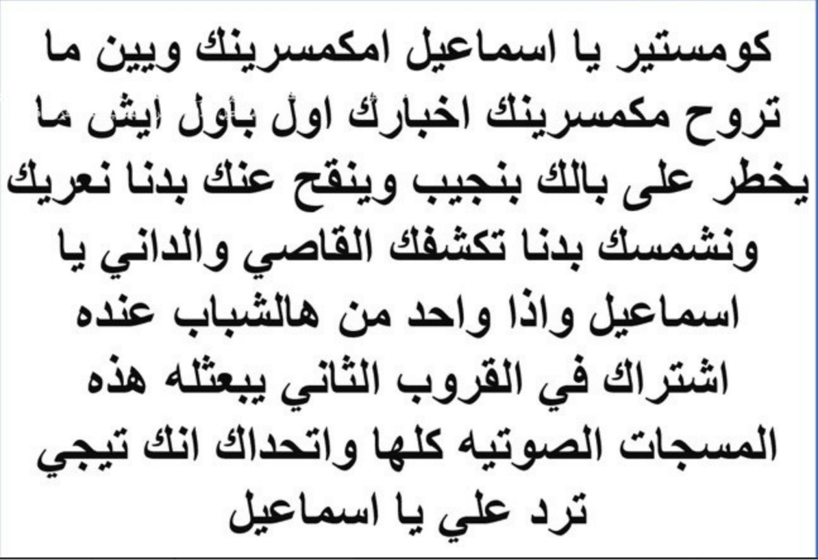
File#
21
Date and time of record
لسماع الصوت بالعريبه اضغط هنا
Comester Ismail, Imkamsereenak (Watching you, you under control). Wherever you go Imkamsereenak (we have eyes on you). You’re news comes to immedietly. Whatever comes to your mind, we are able to reach it. And we spy on you. We need to tell everyone what is behind your reality and let it beome known to the public. And we need to let anyone far or close know your fake reality.
If someone is in the other group, please send all these voice messages to him and I challenge him to reply.
كومستير يا اسماعيل دايما كومستير امكسرينك وين ما تروح مكمسرينك اخبارك اول باول ايش ما يخطر عبالك بنجيبه وبنقح عنك وبدنا نعريك ونشمسك ونكشفك للقاصي والداني يا اسماعيل واذا واحد من هالشباب عندوا اشتراك بالقروب الثاني يبعثله هاي المسجات الصوتيه كلها واتحداك تيجي ترد علي يا اسماعيل
A

Slide 22
File#
22
Date and time of record
لسماع الصوت بالعريبه اضغط هنا
Now my uncle Omar is there (in America). Ask him, the watch maker, who was putting batteries, for a quarter of a Jordanian Dinar, later on the priced increased to 1JD, and the price of watch cleaning was between .5-1JD. This income is not enough to buy an apartment and you can’t buy the land of Jabal Alkursi and you can’t buy land to build apartments and he said (Ibrahim Abu-Haltam) : My father, he built it and he made it. Your father, from where did he get it?
Your father used to clean the watch for .5 JD, barely did he have 5-10JD income per day to take home. So from where did your father build all this? It is clearly from the wealth of my unclues Taha and Abdulfattah. The truth only becomes revealed. You are a liar and keep lying and you make stories up that your father created this wealth. From where did he get that.
AMohammad Saeed (Continued in next slide)
هي عمي عمر عندكم واسالوه قولوله الساعاتي الي كان يركب بطاريه بربع ليره بعدين غليت البطاريه وصارت نص ليره واو بعدين ليره ويمسح ساعه بنص ليره وبليره يمسحوا الساعه ببني عمارات بشتري اراضي بجيب اراضي بجيب جبل الكرسي ولا بشتري ارض وببني عماره بقلك كله هاظا من ابوي ابوي الي بناه ابوي الي سوى ابوك من وين له ابوك كان يمسح الساعه بنص ليره يا دوب يخلص خمس خمس ليرات عشر ليرات في اليوم يروح فيهن بس من وينلو ابوك بنا كله هاظا من خير اعمامي من خير عمي طه وعمي عبد الفتاح ما يصح الا الصحيح انتا واحد كذاب بتكذب وبتالف انه ابوي جابهن من وينلو جابهن محمد سعيد

Slide 23
File#
23
Date and time of record
لسماع الصوت بالعريبه اضغط هنا
Muhammad Saeed, the son of my uncle Ibraheem, tells me his father bought the store in Wehdat from his hard work and sweat.
From where did he get his sweat and hard work? Answer? From where? From where did you get this, show us the sources of your father’s income in which you claim he got from his sweat?
When he worked on 1 table in Abu Khalil store and he installed batteries and cleaning watches and price of the battery was a quarter dinar and cleaned the watch for half a dinar. Our whole lives we knew this story. And after that he told Abu Khalil that he needs to add another table and Abu Khalil told him (Ibrahim AbuHaltam): Listen to me, take your merchandise, all your merchandise and get out of my store, may God be with you, don’t stay in my store.
All of you know Abu Khalil the barber, who is in Wehdat.
محمد سعيد ابن عمي ابراهيم بقلي ابوي اشترى محل الوحدات من تعبه وشقاه من تعبه وشقاه جاب محل الوحدات من وين له من تعبه وشقاه شو من واين من اين لك هاذا طيب ورجينا اعطينا مصادر الاموال الي جابها ابوك من تعبه وشقاه هوو الي بمسح بطاريه كان عند ابو خليل حاطت طاوله كان عند ابو خليل حاطت طاوله ويركب بطاريه ويمسح ساعه البطاريه بربع ليره والمسح بنص ليره طول عمرنا بنعرف هاظا الحكي من وين له لمنه صار يقله يا ابو خليل بدي احط كمان طاوله بعدين قله ابو خليل شو رايك تطلع من المحل ابو خليل قله اسمع خذ بظاعتك كلياتها والله معك انطلق ما تقعدش عندي بتعرفوه كلياتكوا ابو خليل الحلاق الي في الوحدات

Slide 24
File#
24
Date and time of record
لسماع الصوت بالعريبه اضغط هنا
I swear guys, as for myself, I told you, I have a lot of evidence under my hands. I heard many witnesses from my uncles, I heard from my uncle Omar and my Uncle Abdul Fatah. My father Is a treasure of information and he has all the news of the family; Since the day it was formed, In relations to my grandfather Mohammad Saed Abuhaltam. My father has the facts, the complete facts and the way the treat each other. And it shows how my uncle Ibrahim AbuHaltam controlled the entire family. And how he used to boss them and send them to do any job in any place. And all this information we have it with us and we can discuss and explain the mistakes in it and we can show your truth Ismail and we can prove all your information is false and made up.
والله يا اخوان احنا يعني انا عندي عن نفسي بقلكو في جعبتي الكثير الكثير انا سمعت شهادات اكثيره من اعمامي اسمعت من عمي عمر واسمعت من عمي عبد الفتاح واسمعت كثييير من ابوي ابوي كنز من المعلومات وعندوا اخبار العائله من يوم ما اء تشكلت عائلة محمد سعيد ابو حلتم في الاردن عندو الخبر وكامل وطريقة التعاملات وطريقة ال اه كيف عمي ابراهيم كان يتحكم في العائله وكيف كان يست يسترسل عليهم واوو يجيبهم ويوديهم على المكان الي بدو اياه وزي ما بدوه يعني كل هاي المعلومات موجوده عنا وبنقدر انفندها وانعريك يا اسماعيل ونضحض كل كل معلومه انتا جبتها كلياتها معلومات خاطئه

Slide 25
File#
25
Date and time of record
لسماع الصوت بالعريبه اضغط هنا
Whatever wakes up mine and other’s attention in this case that he is joking and Ismail uploaded to the group, and he is aiming Seedna (Our spiritual leader). What he was saying in his joke is that someone loses his money and after he loses his money he asks God, I hope that a religious leader does not find the money because he will find a fatwa (religious excuse). And he means the land of Yaduda fell in between the hands of our Seedna (Our spiritual leader) and he said this land is Waqf (Belongs to Allah). Because of this joke , he said (Ismail), it made me very angry and I want to expose Ismaill and show everyone he is a liar. Anyone that supports Ismail, with his liar like Mohammad Saeed AbuHaltam, for example, also Abdulrahmat Abuhaltam and everyone supports him is my enemy.
ايه الي اثار حفيظتي وحفيظة ناس اكثير يا شباب هون اييه الي هو نكته نزلها اسماعيل يقصد فيها حضرة سيدنا شو بقول في النكته بقول انه واحد ظيع مصاري واوو بعد ماظيع مصاري قال يا رب ما توقع بايدين شيخ لانه بلاقيلها فتوه يعني قصدوا انه ارض اليادوده وقعت بايدين حضرة سيدنا وقلهم هاذي وقف انه يعني الي قالها فتوه افهمتوا كيف فا هاي اثارت حفيظتي واخذت على نفسي عهد اني اعري اسماعيل والي بشد على ايد اسماعيل من امثال محمد سعيد ابو حلتم وامثال عبد الرحمن ابو حلتم كل واحد بشد على ايد اسماعيل خصمي

Slide 26
File#
26
Date and time of record
لسماع الصوت بالعريبه اضغط هنا
Mr. Suma’a (Ismail Abuhaltam) has resentment buried deep inside him and he has resentment towards everyone in the family, individually. That means he has resentment towards my uncle Abdulfattah and resents my father as well. As well as my uncle Omar and he resent each one of my uncles. He has deep resentment on top of resentment.
ايه مستر سمعه عندو احقاد ايه دفينه اوو حاقد على كل واحد في العيله على حدا يعني حاقد على عمي عبد الفتاح حاقد على ابوي حاقد على عمي عمر حاقد على كل واحد من اعمامي حقد دفين ومخمر حقد مخمر

Slide 27
File#
27
Date and time of record
لسماع الصوت بالعريبه اضغط هنا
That means now that we have the right on it (we have ownership right to the land of yaduda). The truth, Hajj Qawasmi did not only garauntee the amount of it. In reality he paid for 30 Dunums. And the condition is to give the money back to Alhajj Ishaq Alquwasmeh. And Waqf (Money of Allah), owns it. And whoever told you this information, it is false, incorrect. It is a plan of my uncle Ibrahim Abu-Haltam. The most important thing is that this land was paid as a repayment of a debt. Because my uncle Ibrahim does not have the money to pay back Hajj Ishaq, and he does not have the money to pay his debt to the Waqf (The money of Allah, God). That means, all the land, all of it has gone as a debt repayment.
Tell him to change his mind and he corrects his lies and starts from the beginning, and he rephrased the lies Mr. Sumaa (Ismail Abuhaltam).
يعني هسا صار النا فيها عشان تخطيط عمي ابراهيم بعدين الحج اسحاق القواسمي ما تكفل الحج اسحاق القواسمي دفع عنه حق الثلاثين دونم الثانيات على اساس يسدوا الحج اسحاق القواسمي بعدين الوقف سد الدين للحج السحاق القواسمي الي قلك المعلومات هاذي كلها غلط تخطيط عمي ابراهيم وتخطيط ابصر مين المهم هاذي الارض راحت سداد دين لانه عمي ابراهيم ما قدر يسد الحاج اسحاق ولا قدر يسد ايه الديون الي عليه للوقف كلياتها وراحت سداد دين ايه هاظا الحكي مش مزبوط قوليلو عدل عدل افكارك عدل الكذبه من اول وجديد سوي اعادة صياغه للكذبه مستر سمعه

Slide 28
File#
28
Date and time of record
لسماع الصوت بالعريبه اضغط هنا
My Aunt (Aunt Nawal) we know the truth. Ismail is a member of the international Zionists and his enmity towards our Seedna (Spiritual Leader). He has resentment towards Seedna (Our Spiritual Leader). And all the family of Quwasmi in general. His resentment towards them is huge, as big as this. He needs to get revenge and the way he needs to get revenge, he needs to show Seedna (Our spiritual leader) he steal the land of my uncle and the land of his father. However you will never get what you are looking for. We will stand on your road. We will be like a thorn in your throat.
يا عمتي احنا بنعرف الصحيح هاظا اسماعيل من الصهيونيه العالميه وأو عداوته مع حضرة سيدنا في عنده احقاد على اه حضرة سيدنا ودار القواسمي بشكل عام حقده عليهم اكبييير بهذا الحجم فهوى بدوا ينتقم كيف بدو ينتقم بدوا يطلع سيدنا انه ماكل حق اعمامي وحق ابوه بس ولكن فشرت عينك يا اسماعيل رح انظلنا واقفين زي ال زي المصمار في طريقك وشوكه بحلقك

Slide 29
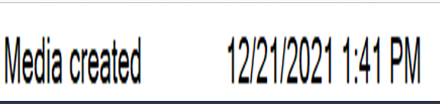
File#
29
Date and time of record
لسماع الصوت بالعريبه اضغط هنا
And you will remember what I said guys when God divides Ismail into two pieces. And when God takes his soul and you will say SubhanAllah, indeed this man Allah has trule punished him because he has tried to stand against the WAQF (God’s money). And stood in front of Seedna (Our spiritual leader) and Allah will break him and defeat him, as the son of Amar in Zarqaa (AlZarqa is A city in Jordan). And also he broke (defeated) Husni Sharif (son of the sister of our spiritual leader). Everyone standing in front of WAQF (God’s property) he gets broke, he gets broke, he gets broke. Do not stand in a battle you can’t stand with someone who is an oppressor. If you stand with an oppressor you are always a loser. He is an oppressor (he oppressed his father) and he oppressed all his uncles and his cousins. This human is an oppressor. He does not belong to us and he is related to our blood (if someone kills, we will not question him). We don’t need this cousin, nor a Zindeeq (Zindīq (pl. zanādiqa) is an Islamic pejorative applied to individuals who are considered to hold views or follow practices that are contrary to central Islamic dogmas. Zandaqa is the noun describing these views(Kaffir)). I swear to God if you kiss the poop of my uncles, one by one, this will not protect you from me, I swear I will hit you with my complete hand in your face and I will you ringing like a bell teacher Sumbuk.
(Sumbuk and Suma’a : two nickname Ayman use to refer to Ismail. A=B B=C, A=C therefore it’s a fact based on the property of transvisity, look at record number 29)
Now I am tell you and warning you and me and you and the future will prove what I am saying, and I will meet you one day, and I will hit you with my full hand like your son Ismail Ibrahim Abuhaltam he hit you with your full hand and stuck you to the couch and I will hit you in your face exactly how your son hit you.
ورح تذكروا كلامي يا شباب لما اسماعيل ربنا يقسمه نصين ويوخذو اخذ عزيز مقتدر وتقولوا سبحان الله فعلا لله في خلقه شؤون انه هاظا الزلمه فعلا الله جزاه وعاقبه لانه كان واقف قدام الوقف وقدام حضرة سيدنا زي ما كسر اولاد عمر في الزرقه وزي ما كسر حسني الشريف وزي ما كسر في باقه الغربيه وناس في نوبا وناس في الخليل اتكسروا كل واحد وقف قدام الوقف انكسر انكسر انكسر لا توقفوا انتوا مش قد مش قدها لا تدخلوا فيها معركه خسرانه بتصفوا مع الظالم معركه خسرانه هاظا ظالم ظلم ابوه ظلم اعمامه ظلم اولاد اعمامه كلياتهم هذا انسان ظالم احنا برئين منه لا بدنا هيك ابن عم ولا زنديق والله ولو بتبوس خرية اعمامي واحد تلو الاخر ما يمنعك عني يا سمبك غير اشمطك الخمساي واخليك اترن رن يا معلم يا سمبك هيني حكيتلك اياها وانا واياك والزمن طويل ورح اتلاقى معك يوم من الايام وشامطك الخمساوي زي ما ابراهيم اسماعيل ابراهيم ابو حلتم شمطك الخمساوي ولزقك في الكنبايه رح اشمطك الخمساوي مثل ما شمطك اياه

Slide 30
File#
30
Date and time of record
لسماع الصوت بالعريبه اضغط هنا
All the deception will fall on his head. Maybe his deception will win one round, but the truth will win all the rounds. We are ‘Knights of Truth’ (‘Fursan Al Haqq’, is a gang which Ayman claims to belong to. And this gang claims to be a religious authority)
By God’s will, we will defeat the truth and we will protect the property of my aunt and the property of our fathers. And he can go to hell and he will pay the price. Now, the time has come for him to pay the price.
This cheater of trust, this man, he has a case cheating the documents which belong to the land in Duwayma (A land which has occupied by Israel in 1948)
He was sending the documents of the land to the son of Al Khayria (The wife of my grandfather Mohammad Saeed Abuhaltam, which died in 1979).
And he said to the son of Khayria, you own land in al Duwayma. And you will have a share of it.
اييه بدها تطلع على راسه ايه للباطل جوله وللحق صولات وجولات احنا اصحاب الحق احنا فرسان الحق باذن الله تعالى احنا بدنا اندافع عن الحق حق عماتي حقنا حق ابياتنا وهوا يروح ينقلع بستين قلعه بدوا يدفع الثمن هسا آن الاوان انه يدفع الثمن هاظا ال خائن الامانه هاظا بعدين في عليه قضية سوء أئتمان كواشين الدوايمه بروح يوديهن لاولاد خيريه كمان انه لسا بحكيلهم للاولاد خيريه انه عنا اراضي في الدوايمه بطلعلكوا منهن

Slide 31
File#
31
Date and time of record
لسماع الصوت بالعريبه اضغط هنا
Essam, my dear friend, as I have already told you he needs to make a story to reach a point explaining ot the public, the good worshiper and asthtetics which don’t take much of this life. It turned out they are planning to steal the land of other people and they do not recognize the land of other people. Oh guys, imagine, imagine, how much the case is big and this gives a very bad reputation of our spiritual leader and spiritual way.
And he said, anyone which needs to discuss with me needs to stay polite and keep his mouth clean. Oh you are a jahl, you are ignorant, you need to discuss with me . You claim (Ismail), we are ignorant and he said I need to inform you and if you need to discuss with me discuss politely. But in the reality he was attacking other people yet telling us to speak politely.
ماهو يا عصام يا حبيبي زي ما قلك اخوي امين بدو يوصل لمرحله انه يقلهم تع شوفو هاذولا العباد الزهاد الي بقولوا عن حالهم عباد زهاد هاذوله طلعو ايش اكلين حقوق واوو منكرين حقوق وكذا فا انتا اتخيل اتخيل عظم الموقف عند الناس الاساءه بحته للطريق اساءه بحته للطريق الي هوه كمان بادعي انه قال الي بدو يناقشني يناقشني بادب اه اه يا جاهل يا ابو شخه بتيجي بتناقشني يا جاهل جهله انتوا بدي اعلمكوا بس ناقشوني بادب يعني بسب وبقلك احكي بادب بسب وبشتم وبقلك احكي بادب

Slide 32
File#
32
Date and time of record
لسماع الصوت بالعريبه اضغط هنا
Oh, all the bad characteristics belong to you. All the criminal traits appear in you. And you have a black heart and all Abu Haltam family have white hearts. And all these characterisitcs and resentments appears in him (Ismail Abuhaltam).
In order to ruin the reputation of his uncles, he said, they have eaten the rights of his father. In reality, their uncle is innocent from him and his dad. And they don’t have anything to do with it, but in reality they are innocent victims of Hajj Ibrahim, God shower him with mercy.
اه جميع الصفات السيئه موجوده فيه اه جميع الحركات الاجراميه موجوده فيه مع ذلك عندوا القلب الاسود الي هوا مش موجود عند واحد من دار ابو حلتم اااه كل هاذي الصفات والاحقاد موجوده عنده عشان يشوه صورة اعمامه وقال عن اعمامه نهشوا واكلوا ابوه واعمامه بريئيين منه ومن ابوه وما الهم دخل واعمامه بل كانو ضحايا ضحايا كلهم عند الحج ابراهيم رحمة الله عليه

Slide 33
File#
33
Date and time of record
لسماع الصوت بالعريبه اضغط هنا
This criminal mind which Ismail has has become clear when my uncle Abdulfatah made his revolution. The revolution of my uncle Abdulfattah, in that time, my uncle Ibrahim, he started to say to Ismail that we own land and he started to give him a story about it, because he is the older son. Exactly as my grand father Mohammad, has treated his oldest son (Ibrahim) as if he is a grown man. And he was explaining everything to Ismail because my uncle Ibrahim considered that Ismail will grant the rights to the property owners. Therefore my uncle Ibrahim believed which the land of Yaduda belonged to us, all of it, and the evidence in the paper in which he inherited from his father and all his bookkeeping is false and the witness was Abu Hisham (The brother of Abdulraouf, the spiritual leader). And Abu Hisham is through worshipper of Allah, and if I am wrong, my uncle Abdulfattah correct me please.
هذا العقل الاجرامي الي كان عند اسماعيل اااه من الاساس كان لما صارت ثورة عمي الثوره ثورة عمي عبد الفتاح ثورة عمي عبد الفتاح صار عمي ابراهيم يقول لاسماعيل كان عنا ارض وراحت ويعطيه معطيات ااه وهوه بما انه ابنه الكبير واوو انه سيدي محمد كان يعامل ابنه الاكبير على اساس انه زلمه ويفهمه الا هو عمي ابراهيم عمي ابراهيم ظن ظن انه اسماعيل بدوا يطلع ااه زي زي هيك بدو يجيب حقوق فا كان مقتنع عمي ابراهيم انو ارض اليادوده النا كامله مكمله بالاوراق الي عندوا وتسجيلاته خاطئه بشهادة سيدي ابو هشام وسيدي ابو هشام ولي من اولياء الله الصالحين واذا انا غلطان عمي عبد الفتاح صححني

Slide 34
File#
34
Date and time of record
لسماع الصوت بالعريبه اضغط هنا
In fact, listen to him, he said, my cousin son of Mustafa, he said, it’s land of Waqf (Belonging to Allah), and this is not from your share. Why you cursed (out of the mercy of Allah). Why you contact me, you speak with me 1 hour, try to convince me to change my opinion. Why, why you contact me, because I know, because you know that I will smash your face with my foot Ismail. I will smash your foot , I will smash anyone stand in the face of Waqf (the property of God) and he stood in the face of his uncle. And he stands in the face of us. You will see with your eyes no hand kissing accepted this time (no forgiveness) Ismail.
لانه سامعيين زا كيف بحكي انه ااه ابن عمي مصطفي قال ارض وقف اوو هاي هاي من مش من نصيبكم ليش بتتصل فييه يا ملعون الحرسه ليش تتصل فييه بت بتحكي ساعه تقعد تقنع فييه اغير موقفي لييش ليش بتتصل لاني عارف لانك عارف لاني رح ادعس على راسك يا اسماعيل رح ادعس عراسك وراس كل واحد يتجرأ على الوقف وبتجرأ على اعمامه وبتجرأ علينا ورح ت رح تشوف بعينك ما في هي المره بوس ايادي يا اسماعيل

Slide 35
File#
35
Date and time of record
لسماع الصوت بالعريبه اضغط هنا
But I am behind you, I am behind you and all future you are under my sight Ismail, I swear to God, we will never leave you, I will never let it go to you easy like that. I swear to God, even the king Abdullah (King of Jordan), if you bring him himself to apologize for you and he brought people to join him to apologize to you and becoming reaccepted to the family, we will not agree and we will not let it go like that.
بس انا وراك وراك والزمن طويل يا اسماعيل والله ما نتركلك اياها تروح بالسهوله هاي والله لو اتجيب الملك عبدالله ابذاته يجيي يتوسط وجاها على راس جاهتك انها ما تروحلك يا اسماعيل مش موافقين

Slide 36
File#
36
Date and time of record
لسماع الصوت بالعريبه اضغط هنا
This is filth and deception, deception. I swear my uncle Abdulfattah 1000 thanks because you saved us from this group of unjust people unjust people.
النجاسه هاذي اسمها نجاسه وخباثه خباثه والله يا عمي عبد الفتاح الف شكر اليك انقذتنا من هذول الظلمه الظلمه

Slide 37
File#
37
Date and time of record
لسماع الصوت بالعريبه اضغط هنا
Everything will fall on your head Mr. Suuma (Ismail Abuhaltam), you are a deceptive seed, all of it will fall on your head.
كله رح يطلع على راسك مستر سمعه يا ايها البذره الخبيثه كله رح يطلع على راسك

Slide 38
File#
38
Date and time of record
لسماع الصوت بالعريبه اضغط هنا
I will ruin your shape God willing, I will ruin your shape. We are tracking you, we are tracking you Ismail.
رح يتعجب على خلقيته ان شاء الله رح يتعجب على خلقيته وراك وراك يا اسماعيل

Slide 39
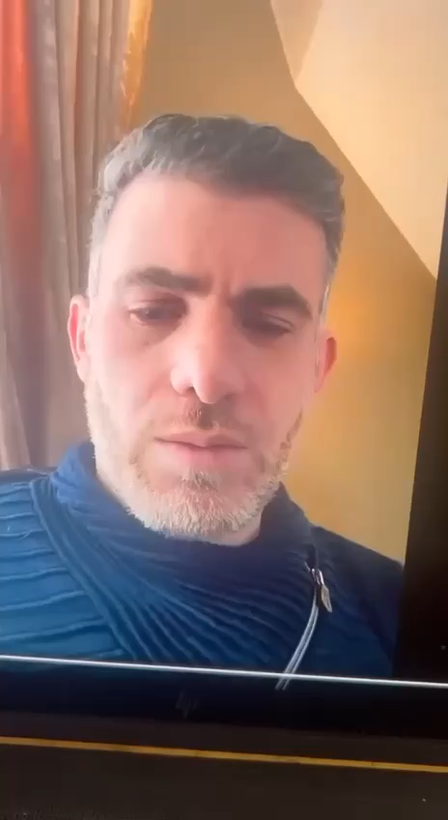
File#
39
Date and time of record
لسماع الصوت بالعريبه اضغط هنا
Peace be upon you, I am Ayman Mustafa Muhammad Saeed Abuhaltam I witness and confess the land of Yadoodeh is gone and redeemed as a debt payment from my dad and all of my uncles in 1992, no one from AbuHaltam can ask for it.
السلام عليكم انا ايمن مصطفى محمد سعيد ابو حلتم اقر واعترف بان ارض اليادوده قد ذهبت بدل سداد دين عن والدي واعمامي جميعا في عام ١٩٩٢ ولا يحق لاي احد من ال ابو حلتم المطالبه بها

Slide 40
File#
40
Date and time of record
لسماع الصوت بالعريبه اضغط هنا
By the way guys focus on his resentment about our Sadatna (Our Spiritual Leader) especially our Hadrat Seednah (Our spiritual leader) AbdulRaouf when he (Ismail Abuhaltam) mentioned Hadrat Seednah he said Hadrat Seedna at the same time he occupied the land and he took the land from us.
Other sayings when his father took the biggest chair in that case the giving of the king does not get refused and in this case they are not becoming kings, they are not becoming kings.
بعدين يا شباب ركزوا في حقدوا على ساداتنا وخصوصا على حضرة سيدنا عبد الرؤوف في عندوا بقول لما يجيب سيرة اسم حضرة سيدنا بحكي حضرة سيدنا وبقول بنفس الوقت محتل الارض واخذ الارض منا وكذا الوقف ااه وفي مقال اخر لما ابو اخذ اكبر حصه هناك في هظاك الموقف عطاء الملوك لا يرد وهان بطل بطلوا ملوك

Slide 41
File#
41
Date and time of record
لسماع الصوت بالعريبه اضغط هنا
We are behind you we are behind you with the revolution Ismail and we will take apart your criminal group, we will destroy your group and that is the criminal goup which you made and we will turn all your plans on your head and you will go to prison Ismail, we will put you in prison.
وراك وراك بالثوره يا اسماعيل ورح نفكك الخليه تبعتك هاي الخليه الاجراميه الي انتا عاملها ورح نطلعها كلها على راسك وراح تنسجن يا اسماعيل رح نسجنك

Slide 42
File#
42
Date and time of record
لسماع الصوت بالعريبه اضغط هنا
My aunt (Nawal) this is a fake paper but in the picture it is a fake paper look at the names above all written in the same font
يا عمتي هاذي ورقه مزوره بس تكوني بالصوره ورقه مزوره اطلعي على الاسماء فوق جميعها مكتوبه بنفس الخط

Slide 43
File#
43
Date and time of record
لسماع الصوت بالعريبه اضغط هنا
I mean Ismail all the paper he have is maybe is fake, especially the letter of my uncle Ibrahim.
He went analyzed it with his written hand with sheikh bassam and analyzed the letter.
You think the handwriting of my uncle needs to be analyzed?
He is not accept to put the original copy, he is analyze it and he said this is the letter take it, welcome to read it.
يعني اسماعيل كل الورق الي معو ممكن يكون اكثروا مزور خصوصا رسالة عمي ابراهيم راح حللها بخط ايدوا هوا والشيخ بسام وفكوا الخط صار خط عمي ابراهيم بدوا فك مرظيش يحط النسخة الاصليه كامله راح قال حللها وقال هاي الرسائل تفضلوا

Slide 44
File#
44
Date and time of record
لسماع الصوت بالعريبه اضغط هنا
And also I need to add for your knowledge, whoever does not have goodness for his own family, he will not have goodness to the public people.
My cousin Aref, God bless his health and give him long age, the most one who got hurt from all my uncles children, my uncle Ibrahim children from Ismail. Ismail caused for him a big big harm for Aref. He harmed him big big and he took away from Aref the son of my uncle many things. God make you strong Aref and bless you in this life and next.
اوو بعدين عشان افيدك انه ال ما فيه خير الاهله ما فيه خير للناس ابن عمي عارف الله يعطيه الصحه وطولة العمر اكثر واحد تضرر من اولاد عمي ابراهيم من اسماعيل اسماعيل الحق ضرر اكبير اكبير اكبير في عارف الحق ضرر كبيير جدا جدا وحرموا عارف ابن عمي من شغلات اكثيره الله يقويك يا عارف ويسترها معك دنيا واخره

Slide 45
File#
45
Date and time of record
لسماع الصوت بالعريبه اضغط هنا
Also the hidden and unknown from my uncle Ibrahim which is written for my Uncle Ibrahim family, witnesses, witnesses, witnesses of Unjustice, you (Ismail) envious, why you are not give him Jordan valley, you paid for it half a million jd and you spent on it you and your father, why you are not give your aunt, why you are not give your aunt, instead you attack him.
You bring sheikh Bassam to write paper Bassam Barhoumeh write paper. Did you know Bassam has a case of orphans, I don’t care about Bassam or someone else. But all of who is here, they know Bassam he have 1000 question mark this Bassam.
بعدين المخبى والمستور من دار عمي ابراهيم والمكتوب على دار عمي ابراهيم شهادات شهادات شهاهدات ظلم يا حسود يا حسود كان اعطيتهم من ارض الغور الي دفعت فيها نص مليون دينار اردني وانتا تفت عليها انتا وابوك ليش ما اعطيتوا اعطيتوا عماتك ليش ما اعطيت عماتك بدل ما تت طخ عليهم انك اه والله جايبلهم الشيخ بسام يكتب ورق قال بسام برهومه يكتبلهم ورق بسام عليه قضية تبعت الايتام انا ما الي ببسام ولا غيروه بس كل الموجدين هانا بعرفوا مين بسام بسام عليه الف علامة استفهام هاظا بسام

Slide 46
File#
46
Date and time of record
لسماع الصوت بالعريبه اضغط هنا
You will never find more corrupted people like this guys, Why my uncle was anyone need from him debt he said all your debt will pay it Alyadoodeh sold, and this guy (Ismail) he came to continue his message and he said for their brothers the land of yadoodeh is yours, the land of al yadoodeh is yours and he only give him illusions. 35 years pass since they are distribute the wealth of my grandpa and my aunt never take 1 penny, my aunt they have not taken a penny from 35 years they will pass another 35 years and you will never take any penny I will cut my mustache if they get 1 hand space from the al yadoodeh land.
انصب من هيك ما بتلاقوا يا شباب ليش هسا عمي كان يحمل كل واحد بدو منه مصاري يقلك بس تنباع ارض اليادوده اجا هاظا يكمل المشوار ويقول لخواته ارض اليادوده الكن ارض اليادوده الكن يشبعهن وهم مر خمسه وثلاثين سنه على تقسيم الميراث وعماتي ما اخذنش قرش عماتي ما اخذنش قرش خمسه وثلاثين سنه وهي يا بنات عمتي رح يمر عليكن كمان خمسه وثلاثين سنه وما توخذنيش تعريفه وهي شاربي بقصه اذا هاظا بطول شبر من ارض اليادوده

Slide 47

File#
47
Date and time of record
لسماع الصوت بالعريبه اضغط هنا
Why do you escape from coming face to face you failure, why do you escape from coming face to face, come to us and speak fact, you have to say what your father did, your father, he’s the one that made division teacher.
Your father put flour to the dough, we were saying he just put it because we are polite, because we don’t need to make bad reputation and we don’t need to mention for someone by himself but you are start to make bad reputation for your father and you send your father picture for one of Amr family to say this is the man he took your right from the land and that man he start curse about your father ; you are cause this bad thing for your father, you pushed my uncle abed and you cursed and wronged him. And you said he took your right from the land and I don’t know whatever else and you push to start telling stories the old story for your father. Yes don’t deny your father was a dictator and unjust and this is the witness for all around him but they can’t say that public because my uncle was dead and they have a little bit of respect for him but you have to be in the picture, yes your father was unjust he caused unjust for my aunts
ليش بتهرب من الواجهه يا ساقط ليش بتهرب من الواجهه تعال نحكي حقائق مهو بدك تحكي شو سوى ابوك ابوك الي قسم يا معلم ابوك الي حط الطحين على العجين بس احنا كنا نحكي حطو ادبا عشان ما نسيئش ولا نعيين لواحد بحد ذاته بس انتا اصريت انك تسيئ لابوك اصريت تروح تودي صورة صورة ابوك لواحد من دار عمر عشان تقوله هاظا الي اكل حقكوا والزلمه ينزل يسب ويغلط على ابوك احنا دافعنا عن ابوك انتا الي اسأت لابوك انتا الي رحت نكشت عمي عبد سبيت وغلطت عليه وانك اكال حق ونكار وابصر ايش عشان يطلع يفتح قصص ابوك القديمه ابوك اه يا سيدي لا تنكر كان جبار وظالم بشهادة الجميع بس الكل ما بيقدر يطلع يحكي على لعلن لانه عمي متوفي وعندهم شوية احترام اله لاء بس عشان تكون بالصوره ابوك كان نعم جبار وظالم ظلم عماتي

Slide 48
File#
48
Date and time of record
لسماع الصوت بالعريبه اضغط هنا
You are disobedient to your parents. You gave your father a hard time as he gave a hard time to my grandpa (Mohammad Said AbuHaltam). You are like him giving a hard time to your father. You are unpolite, as you treat others, you will be treated. And this is how it’s been and this cycle. The sun doesn’t cover with the sieve And we have a witness and the people are talking about that, don’t think because they can’t say that publicly. I will say it publicly. I will be the witness of all of them, this is your father and the son is the secret of his father. You are doing bad things to your dad. You are digging his history to force people to talk about him. Your father tried to steal the land of Waqf (land that belong to God). Our Sadatna (Our spiritual leader) was hiding the truth in order to not make it public until he dies. You convincinced and God took him. You are the reason he died because you put these thoughts in his head and you convinced him in 2006 to change his decision. You told him this land is worth millions, why would Waqf take it from us.
We know you whispered in your fathers ear, you kept whispering in his head forcing him.
يا عاق الوالدين ولك انتا منتا جننت ابوك جننتوا زي ما هو جنن سيدي زي ما هوو كان يقسى على سيدي وغير مؤدب مع سيدي انتا كنت زيه غير مؤدب معاه كما تدين تدان وهاظا الي صار والزمن دوار الشمس ما بتطغطى بغربال وعنا شواهد والناس بتحكي تفكرش انه بدهمش يحكوا لاء انا بطلع بحكي عن الكل بحكي على السان الجميع عشهادات الجميع هاظ هوه ابوك وهاظا انتا والولد سر ابيه انتا الي بتسيئ لابوك قاعد بتنبش بتنبش في قصصه عشان اطلعنا نحكي عنه ابوك كان بدوا يوكل ارض الوقف وساداتنا ظلوا مستريين عليه لمنه الله اخذ اوداعته ولمان انك اقنعته قله قله ربنا تعال اريحك يا ابراهيم الله اخذه وكان السبب انتا بموته كمان لما انتا حطيت هاي الافكار في راسه واقنعته ب الافين وسته انه يرجع عن رأيه صرت اتقله ارض بالملايين الوقف يوخذها منا محنا عارفين انتا الي وسوست انتا الوسواس انتا الشيطان قعدت توسوس في راسوا خليتوا يغير اقواله

Slide 49
File#
49
Date and time of record
لسماع الصوت بالعريبه اضغط هنا
We know you and your tricks, you are envious. You did not leave anyone in AbuHaltam family that you didn’t envy. And you have done this with everyone, even the wife of my uncle Taha, may God have mercy on her. You followed her, looked at her and envied her. You looked at her house in shmesani and when you came back to wehdat you said we are living in hell and they are living in paradise. You claimed the money they enjoy are from their father. Your father spent his money to slaughter sheep and feed the family of Abuhaltam. My grandma told my grandpa God’s mercy on her. They are living in Jordan with luxury and here we are in Bethlahom a quarter of a kilo of land. My grandpa said let him create for him an environment for him and for his brothers full of respect because he feeds them. From where do you think comes the cost of these sheeps. It’s from the hard work of my uncles. He was briniging these sheep to slaughter them. He stopped doing this habit after they divided it. The family of AbuHaltam stopped eating sheep because your father stopped s
امكمسرينك احنا وكاشفينك وكاشفين الاعيبك يا حسود يالي ما خليت واحد من دار ابو حلتم الا اتطلعت عليه على رزقته وحسدته ما خليت واحد انتا لما اعرفت حتى في كل اشي مرت عمي طه الله يرحمها ويحسن اليها ليسا الحقتها وصرت تتمظرت عليها وتحسد فيها وتروح على دارهم في الشميساني وترجع على داركوا في الوحدات وتقول احنا في جهنم وهمه قاعدين في الجنه وبتبرطعوا وبتبرطعوا فينا وفي مصارينا بتدعي انه هاي مصاري ابوك ابوك صرف مصريه على التيوس يذبح لتيوس للحلاتمه ويطعمي فيهم وتقلو وتقلو جدتي الله يرحمها تقلوا ايش تقلوا عايشين ب عايشين بعز بعمان واحنا واحنا وقية لحمه ما عنا وقية لحمه يقلها سيدي خليه خليه يعمل لحاله كيان ولاخوته يعمل لحاله كيان ولاخوته قدام الحلاتمه خليه يعمل لحاله كيان يذبح تيوس للحلاتمه من وين لتيوس تعب سيدي وشقى عمامي يجيب لتيوس ويذبحهن لما قسمواابوك بطل يذبح لتيوس ابوك بطل يذبح لتيوس بطل لما قسموا كل واحد راح في حال سبيله راحن انقطعت لتيوس عن الحلاتمه بطل يذبح

Slide 50
File#
50
Date and time of record
لسماع الصوت بالعريبه اضغط هنا
I swear to God we will make you into a mockery, I swear we will make you a joke. Sumbuk, Sumbuk, Oh Mutasambik, you mockery, you fool.
والله لنسويك مسخره والله لنسويك نكته يا سمبك سمبك يا متسنبك يا مسخره يا سفيه

Slide 51
File#
51
Date and time of record
لسماع الصوت بالعريبه اضغط هنا
If God wills I will contact with my network and friends and relativies and my people from the Jordanian brothers and I will ask them for a health report about one known as Sumbuk. Maybe this guy in reality has a a sickness and is ignorant. Let us research and see his report because this guy in reality have bad reputation to his proud family. And he has a bad reputation to my uncle and my beloved aunt. And even though he brought a bad reputation for his father in reality he did that for his father. What comes out from him does not help. His situation is declining. His mental health, truly I am speaking the truth. Because we heard stories from other people, this man in the past. He got a short in his head and I am not doubt about that because you know the environment of the camp is criminal environment and aggressive environment. This is a big deal and maybe he got affected in his mind and it broke.
ان شاء الله رح اتوجه بمعارفي واو اصحابي واصدقائي وعزوتي وناسي من الاخوه الاردنيين واطلب منهم تقارير صحيه عن المدعوا سمبك واو بلكي هاظا الزلمه فعليا عن جد كان عندوا مرض وسفه فيه خلينا نراجع ونشوف تقاريره لانه هاظا فعليا اساء للعائله الكريمه واساء لاعمامي الكرام واساء لعماتي حبيبات قلبي واو حتى اساء لابوه حتى لابوه اساء يعني ما هاظا الاشي ما بطلع من انسان عاقل فممكن يكون في صغره متعرض ل اشي أدى الى تدهور حالته النفسيه فعليا انا بحكي كلام صحيح لانه بنسمع قصص من ناس انه هاظا الانسان صار في مشاكل عنده بل الماضي ادت الى شرط في راسه واوو هاي يعني ما استبعد لانه اصلا يعني بتعرفوا جو المخيم جو اجرامي واو جو عدائي واو ممكن يكون اتاثرلشغله اكبيره هاي اثرت بمخه وشطبته شطب

Slide 52
File#
52
Date and time of record
لسماع الصوت بالعريبه اضغط هنا
I swear to god I swear to god I swear to god you will never get yadoodah land under our dead body you take her (yadoodeh land). If we got hung and we die, you will not get a handpsace from the land of yadoodeh sumbuuk. We will show who we are and who you are and how much your value.
Abdulrahman, you mentioned, he is worth nothing. My authorizer my authorizer he is your instead you in the aggression, Abdulrahman, who is Abdulrahman.
والله وبالله وتالله على جثثنا بتوخذها يا سمبك
لو بنروح فيها اعدامات وموت انك ما رح اطول شبر من من ارض اليادوده يا سمبك وبنورجيك مين انتا ومين قيمتك عبد الرحمن تبعك انقعوا وشرب ميته وكيل وكيلي وليك في الظلم عبد الرحمن مين عبد الرحمن

Slide 53
File#
53
Date and time of record
لسماع الصوت بالعريبه اضغط هنا
But you because of the dirt and disgust that you have all of it. You figure out you need to throw it for your uncle, and you see all your cousins are successful in America, you are the only loser in America you loser and you come to envy them because they have wealth which is around them, you need to envy them like you envied my uncle taha because he had the wealth. You do not leave anyone until you envy him. Even someone tried to sell some plants in front of your shop you look for his income even the son of abu serhed (my aunt children). You do not let him have a business infront of your store.
Who ate the flesh of whome who make unjustive for others who is make unjustive for your uncles your uncles they live under the dictatorship of my Sumbuk.
اما انتا عشان الوسخ والقرف الي عندك كلياته هاظا بدك تزتوا على مين بدك تزتوا على اعمامك عشانك فاشل شايف كل اولاد اعمامك ناجحين في اميركا وانتا الفاشل الوحيد في اميركا يا فاشل صرت بدك تحسدهم على النعمه الي همه فيها زي ما حسدت عمي طه على النعم الي هوو كان عايش فيها واوو حسدت عمي عبد الفتاح ما خليت واحد الا وحسدته حتى صاحب بسطة الزريعه اطلعت على رزقته حتى اولاد ابو السرهد حرمتهم يبسطوا قدام محلك مين الي اكل لحم مين ومين الي ظلم مين مين اعمامك اعمامك الي عاشوا تحت جبروت عمي ابراهيم اه جاوب يا سمبك
1- السانك هذا الذي يجتر خرى زي ثمك هذا ثمك المليان خرى وتنك النظر اللي جوهاتك بدكي تطلق علينا لانك انسان فاشل حاسدنا انت لحاسود انت حاسدت كل واحد في داره بحالتك تطلعت على اللي بييد وحاسدته تطلعت على اللي بييد بأميركة جيت على عمي طاها مرة تبتتسوق بالواحة جيت على عب صر مين هذا ليش بصرف أكثر منه هذا رحعا ديزنيلاند أنا ظلتني مجهور مرمي في الوحدات عندم سلطان النري أنا أنا طول هارا اتصبح وتمسف وجهه أم سلطان وعمي داير في ديزنيلاند بشم الهواء هو ولاده ديتها ذاك عايش فيش ميساني في البلد الراجع اللي انت كانت بالنسبة لكش ميساني بلاد غريبه أرض الأحلام كانت بالنسبة لك لانك انت تل عمرك في حوار الوحدات وراسك مليان ريحة صناين وخماج وداير بها الزجاج يا أم حافي يا أم بنتلونا كمزع

Slide 54
File#
54
Date and time of record
لسماع الصوت بالعريبه اضغط هنا
May the curse of Allah be upon you Sumbuk , May God curse you and your likes and whoever looks like you, you are a cursed satan. I swear to God, I swear to God you are a foxy and cheater and theif and you’re fake and you are a deceiver, and the bathroom rugs are more pure than you, you said your uncle are cheaters and you stutter when you speaker, eeehhhhh, oh okay go master who are smart enough and educated, first learn how to put words together and to speak. Don’t shake with high adrenaline, you look like you are about die and become rotten shortly. May God take you, destroy you and rid us of your bad thing and your uncle gets really disguster disgusting
الله الا لعنة الله عليك يا سمبك لعنة الله عليك وعلى امثالك وعلى شاكلتك يا شيطان يا رجيم اقسم بالله العظيم اقسم بالله العظيم انك واحد محتال وغشاش ونصاب ومزور ومدلس وانه ممسحة الخارج انظف منك واطهر منك اعمامك نصابين وبتئتئ وانتا بتحكي واناءءءءبتط اه طيب روح يا متعلم يا بتاع المدارس اتعلم كيف تحكي وتصف الحكي مش بترج الادرنالين عندك طالع شكلك بدك تفطس عن قريب الله يوخذك اخذ عزيز مقتدر ويريحنا من شرك ويريح اعمامك من قرفك يا مقرف

Slide 55
File#
55
Date and time of record
لسماع الصوت بالعريبه اضغط هنا
Shut up, shut up, I swear to god no one bring bad reputation for my uncle Ibrahim just you, no one hurt him like you. You are retarded and filthy and rotten and low quality and disgusted and unpolite. You need to shut up us, I swear to God you are not able to do that you failed. You can’t do it you or one million like you you can’t stop us to speak. We are supported from God we are supported from God Almighty. We are the knights of truth. We are loudly saying the truth. And no one can stop us from saying the truth, oh retarded sumbuk.
خرسه تخرسك خرسه تخرسك والله ما حدا اساء لعمي ابراهيم الا انتا ما اسائله غيرك يا منحط انتا واحد قذر نتن سافل وقح قليل ادب بعدين بدك تخرسنا والله ما فشرت لا انتا ولا مليون زيك ولا من امثالك انك يخرسنا ولك احنا مؤيدين مؤيدين من الله عز وجل كلنا هون فرسان بالحق نصدح بقول الحق ولا تاخذنا بالحق لومة لائم يا سمبك المفزلك

Slide 56
File#
56
Date and time of record
لسماع الصوت بالعريبه اضغط هنا
My brother Afeef we have a saying that the son of a bastard , do not bother with him, he will fall alone. So do not worry about him and don’t put him in your mind. Put your hands and feet in cold water and watch and be happy for the situation of Sumbuk. As you like. We are following you we are spying on you all the time. Eat almonds and sugar and enjoy as you are watching him. I will let all Abu-Haltam enjoy and eat almonds and sugar as they are watching Sumbuk. All of you, all of you, enjoy his trouble that he is in, even the closest relatives are enjoying seeing him in trouble. All the world loves to see him in troble.
يا خوي يا عفيف في مثل بقلك ابن الحرام لا ادزو بوقع لحاله فلا اطوله ولا على بالك حط ايديك ورجليل بمي بارده ومزمز على سمبك على كيف كيفك وراه وراه والزمن طويل وظلك اضحك وقرش لوز وسكر غير اخلي كل دار ابو حلتم تقرش لوز وسكر على سمبك وكلياتكو وكلياتكوا وبما فيهم ناس مقربين اله وشمتانين فيه مقربين اله كثير وشمتانين فيه كل الدنيا شمتانه فيه

Slide 57
File#
57
Date and time of record
لسماع الصوت بالعريبه اضغط هنا
Why, because love is from God, the whole world hates you, all the world hates you and hates your actions and behaviors, they hate the charisma that you have, the despicable, despicable narcissistic personality, the first of them are your brothers, uncles, family and those close to you and you become a jerk, your name has worthless for the family of Abuhaltam.
ليش لانه المحبه من الله كل الدنيا بتكرهك كل الدنيا بتكرهك وبتكره افعالك وتصرفاتك بتكره الكارزما الي عندك الشخصيه النرجسيه الحقيره الدنيئه اولهم اخوتك واعمامك وعيلتك والمقربين اليك مسخره عامل عامل حالك مسخره لانك صار اسمك سفيه دار ابو حلتم يا سفيه

Slide 58

File#
58
Date and time of record
لسماع الصوت بالعريبه اضغط هنا
I will be following you, following you, following you, until I take the idea from your head. This idea from your head, and I will take it from your head and you will come kiss the foot and you will say the land of Yadoodeh is Waqf (the land of Allah), I will keep following you until you said the land of yadoodeh Almufazalk(not accept anything) if you return they return.
رح اظلني وراك وراك وراك وراك لمني اطلعها من راسك واخليها تطلع من راسك وتيجي تبوس القدم وتقول ارض اليادوده وقف رح اظلني وراك وراك لمنك تقول ارض اليادوده وقف يا سمبك المفزلك وان عدتم عدنا

Slide 59
File#
59
Date and time of record
لسماع الصوت بالعريبه اضغط هنا
Sumbuk are you a man, when you go to Jordan Sumbuk I swear to God I will ask my guys drag you dragging like a rag. And they will put inside you a big stick like that and they will insert it inside you. I will not say where because its shame but you are not polite. I will step in your mouth, I swear I will step in your mouth. I will come and slap you in one cheek. In one cheek I will slap you 20 times tick tick tick tick tick. I will let your teeth fall sumbuk, may Allah make you ugly cochroach. You are a foxy fox, evil, liar, changer of truth, plagiarizer. I swear to God I will destroy you. I swear to God I will destroy you and God is witness for what im say. If I put you in my mind I will destroy we have a military behind us loser loser. We are always busy, we can’t respond to you, we need to take a breath from christamas. And you have time to send many messages, messages, messages. And you are attacking people you have nothing to do. You are a loser that’s why you became bankrupt. Because you are bankrupt you are trying to steal the land of Waqf as you stole the money of your brothers. Anyone of your brother who stands with you you will also get the same bad deeds. Anyone who supports you, whether he is small or big from your brothers I will step in your mouth. And anyone need to protect you I will step on him too sumbuk. I swear to god I swear to god I swear to god and I am truthful, the first time I see you I will smash you with my full hand to destroy your teeth sumbuk. I will smash you to make your teeth fall down in front of you and I swear to God. Mountain to mountain they don’t come close but human to human can meet, when I see you I will destroy you sumbuck.
سومبك زلمه انتا بس تنزل عالاردن يا سمبك والله لخلي الشباب يسحلوك سحل سحل يسحلوك ويحشوا عصايه عصايه هيك هيك كبرها يحشوها جواتك بديش احكي وين عيب بس انتا واحد ما بتستحي غير اخبط على ثمك ولا ولا والله لخبط على ثمك آجي اخبط عثمك غير اشمطك خمساوي على خد واحد عشرين خمساوي هييك تك تك تك تك تك خلي اسنانك يكتن كت يا سمبك قبحك الله يا جندب ولك يا ثعلب يا ماكر خبيث كذاب مدلس مزور مزور والله العظيم بدمرك اقسم بالله العظيم بدمرك والله على ما اقول شهيد بحطك براسي اني بدمرك يا سمبك ولك عنا عنا جيش ورانا جيش جيش يا فاشل يا فاشل طول اليوم واحنا شغالين مش قادرين نرد عليك لنوخذ نفسنا من الكرسمس وانتا قاعد بس مقظيها تودي مسجات مسجات مسجات وطخ لا عندك شغل ولا عندك اشي فاشل عشان هيك فلست بدك بدك تروح على ارض الوقف ..تلهفها تلهف ارض الوقف زي ما لهفت مال اخوانك وكل واحد بوقف معك من اخوانك عليه اثمك الاثم الي انتا بتوخذوه اخوانك بوخذوه من وراك مين ما كان يكون غير اخبط عثمك واذا واحد بدوا يحامي عنك عن اخوانك بدوا ييجي يوقفني بدي اخبط عليه كمان يا سمبك بدي اخبط عليه اي واحد بشد معك وبشد على ايدك يا سمبك بدي اخبط عليك وعليه بدي اخبط عليك وعليه يا سمبك والله العظيم قسما بالله قسما بالله قسما بالله واني صادق بيميني غير اول ما اشوفك غير اشمطك خمساي يكتن اسنانك يا سمبك غير اشمطك خمساوي يكتن اسنانك قدامك والله على ما اقول شهيد وجبل على جبل ما بلتقي بس بني ادم على بني ادم بالتقي والله لاعجب عليك يا سمبك

Slide 60
File#
60
Date and time of record
لسماع الصوت بالعريبه اضغط هنا
If all the family of Abu-Haltam stands behind you to support you, I swear to God, even if all the Muslims try to support you, nobody can stop me from attacking you. And anyone that supports you, I will humiliate him with you. A cursed person, a pig. I swear to God, I will push a stick in you Sumbuk. I will drag you on the streets, drag, drag. And I will unclothe you in front of the creation of God. And I will show them who Sumbuk is. The enemy of Allah and his prophet.
لو كل دار ابو حلتم توقف وراك والله العظيم لو كل امة لا الله الا الله توقف وراك ما باتشيلني عنك ومين بدو يشد على ايدك بدي افضح عرضه معاك واحد ملعون خنزير والله لاحشي العصايه يا سمبك العصايه غير اسحلك بالشارع سحل واشلحك اوعيك قدام خلق الله واورجيهم مين هاظا سمبك عدو الله ورسوله

Slide 61
File#
61
Date and time of record
لسماع الصوت بالعريبه اضغط هنا
You think we are gays like you, you think we are gays? When you are saying you are very strong and then when you need to do something you can’t. As for us we say and take action, we stand by our word boy. We will ruin you, you said we are the group of pampers, drunks and potheads. I swear to God we will ruin you and we will ruin anyone that supports you whoever he be. Even Basboos (Lawyer of Dawaymeh). Whoever you rely on, whoever you rely on. Now I will give him a case of defamation, I will sue him, I will let everyone in Dawaymeh know him. Don’t think someone will support you and anyone that supports you, whatever you can do, get it in your hands and put it in your asses.
بتفكرنا بغاوغه مثلك بتفكرنا بغاوغه بالحكي ذيبك وبالفعل سيبك والله احنا قول و فعل يا ولد قول وفعل لنعجب عليك احنا جماعة البامبرز والسكارا والحشاشين والله لنعجب عليك وعلى كل من يشد على ايدك مين ما كان يكون سواء البصبوص الي حاطيلي اياه هسا بنزل فيه كتاب تشهير بشمسه عند الدوايمه الثاني اتفكرش حدا بشد على ايدك انتا والي بشد على ايدك على على الي بطلع بيدكوا حطوا جوا طيازكو

Slide 62
File#
62
Date and time of record
لسماع الصوت بالعريبه اضغط هنا
I wish you will die. Shame one you, you are not worth one penny, I will not trusth you to raise two sheep.
Hey, I am busy now I have a business I will have time for your , may God humiliate you you bastard.
يعدمي اجدوغك اغص ما بتسوى نقله ولا بسرحك بعنزيتين ولاه لسا بس افظالك عندي شغل يفظح عرضك عرص

Slide 63
File#
63
Date and time of record
لسماع الصوت بالعريبه اضغط هنا
Hey sons of Ibrahim, if you don’t disown him and tell him he doesn’t belong to us Sumbuk and the deeds of Sumbuk. If you say we are not responsible and we deny his actions and you don’t say that only he gets punishment for his deeds. If you don’t say that your sin on yourself as he gets and we will be enemies. And if someone gets murdered it’s okay. Put this blood on Sumbuks neck. It doesn’t matter to us, we don’t care. Our dignity and honor and the honor of our fathers is worth all the world. We put our souls in front of our dignity and honor, we will die from our honor. Not someone very small like this guy not even worth the skin of an onion. He comes and talks bad things about our fathers I swear I will curse your honor Sumbuk and God witnesses what I am saying and I will everyone who doesn’t buy to watch you, you pimp.
هاي يا ولاد ابراهيم هاي يا اولاد ابراهيم هيه ترى اذا ما بطلعوا براءه عن سمبك وافعال سمبك اذا ما بتقولوا احنا بريئين من افعاله وما انا دخل فيه وما بتقولو لا تزر وازرة اخرى اذا ما بتنزلو هاظا الحكي اثمكوا على نفسكوا عداء بينا واذا بصير دم عادي حطوا برقبة سمبك ما بتفرق معنا شرفنا وكرامتنا وكرامة ابياتنا بالدنيا كلها بنحط ارواحنا قدام كرامتنا وشرفنا مش واحد زغنون زي هاظا بسواش قشرة بصل يجي يطعن في ابونا والله للالعن شرفك يا سمبك والله على ما اقول شهيد واخلي الي ما يشتري يتفرج عليك يا قواد

Slide 64
File#
64
Date and time of record
لسماع الصوت بالعريبه اضغط هنا
Your father, just as he scammed my uncles and my aunt and khariya (the wife of my grandpa) now you need to come to scam the Waqf and scam your uncles and attack your uncles and you say bad thing on them, you are wicked. You are shoes, you are garbage and let the talk reach him. And reach every person from Abu Haltam family and every person from Duwam you are a whore. I will curse you I swear to God you whore. You have no shame I swear to God. I will make you wish you were sand you sperm, you stool, you pig. You are unpure sperm. And whoever defend you, whoever you bring. I swear I will curse your honor sumbuk. Whoever you are and whoever supports you. Anyone need to protect you and to say you are his brother he will get punish and attack with you. You will sit down to the judgement. We will ignore your opinion. It’s not as you think. It’s not as you like. You are curse our honor and you curse our father it’s not like you think we are back up from many man and we are heros sons of heros. Your parents are cursed, you are cursed pimp whore.
وابوك زي ما نصب على اعمامي ونصب على عماتي ونصب على خيريه جاي انتا تنصب على الوقف وتنصب على اعمامك وتتهم اعمامك وبتشرح فيهم يا عيب الشوم ما بتستحي واحد نذل كندره زباله وخلي الحكي يوصل يوصل لكل دار ابو حلتم لكل الدوايمه يوصل غير اخبط على ثمك يا قواد والله لالعن شرفك يا عرص ما بتستحي والله مخلي مخليك تتمنا تتمنا انك كنت اتراب يا نطفه خريه واحد خنزير نطفه نجسه نجسه ومين بدوا يدافع عنك مين ما تجيب والله لالعن شرفك يا سمبك لالعنه شرفك مين ما كنت تكون ومين ما كان وراك والي بدوا يشد على ايدك ويقول هاظا اخوي بدوا يلتعن شرفوا معاك كمان وخليكوا تقعدوا للحق غصبت عن شرفكو مش على كيفكو الشغله مش على كيفكوا الشغله تيجوا تسبوا على شرفنا وتسبوا على ابياتنا مش على كيفكوا ورانا ارجال واحنا ارجال اولاد ارجال يا ملاعين الحرسه ملعون الوالدين يلعنك عرص قواد

Slide 65
File#
65
Date and time of record
لسماع الصوت بالعريبه اضغط هنا
Whoever from my uncle that needs to stop me and tell me stop and tell me I don’t know I respect that its up on my head. First I will take my right after that I will stop and obey you. Nobody tell me stop and I swear to god if you go to Jordan I will pay back. I have no problem. I swear to God I will return you to America with a ruined foot. They will go home with ruined foot sumbuk I will drage you in the street and smash your face twent time with my cheek on yours and I let everyone look to you like a free tv show sumbok. And if all dawaymeh unite to save you wil stand right in front of them.
ومين ما كان من اعمامي بدو يقلي هدي ويقلي وقف ويقلي ابصر شو على راسي من فوق باخذ حقي بعدين بوقف بعدين برد عليك ما حدا يقلي وقف وقسما عظما اذا بتنزل على الاردن الا انزل وراك مخصوص الا انزل وراك مخصوص وبنحبس فيك ما عندي مشكله والله لاروحك على اميركا مكرسح مكرسح غير تروح يا سمبك ما برد راسي الا اكرسحلك رجليك ما برد راسي الا اكرسحك يا سمبك واسحلك في الشارع واشمطك عشرين كف على خد واحد واخلي الي ما يشتري يتفرج عليك يا سمبك وكل الدوايمة توقف بوجهي ما تردني

Slide 66
File#
66
Date and time of record
لسماع الصوت بالعريبه اضغط هنا
No one comes to tell me he apologize in front of people. I swear if you kiss the stool of my father you don’t belong to me you infidel. I am innocent frm you incidence. I swear to God if you kiss the stoll of my uncles I will never forgive you or recognize you. If you apologize or don’t apologize you are bankrupt. Your idol been broke, now you are not worth any penny in the good markets. Not even one penny is your worth in the good market you infidel. You have no conciouse.
ما حدا ييجي يقلك اعتذر ما تعتذر قدام الناس تيجي تضحك على الناس بكلمتين والله لتبوس خرية ابوي انا بريء منك يا زنديق والله لو تبوس خرية اعمامي كلياتهم ما بسامحك ولا باعترف فيك كابن عم سوائن اعتذرت ولا ما اعتذرت انت افلست صنمك انكسر خلص لا تسوى لا فلس بسوق الغلى فلس واحد ما بتسوى بسوق الغلى يا زنديق عديم الشرف والاحساس والضمير

Slide 67
File#
67
Date and time of record
لسماع الصوت بالعريبه اضغط هنا
No one tell me to stop. Because he stand up and pologize. Get out from my face. Get out from my face you too. Amnyone need to tell me stop no one I am not accept it. No one tell me stop. Not your father got attacked my love.
ما واحد ييجي يقلي اسكت عشان هيه خلاص طلع اعتذر امشي انقلع انتا معه الي بدوا ييجي يقلي اسكت ما حدا يقلي اسكت قال اسكت قال قال اسكت مهو مش ابوك الي انسب يا حبيبي

Slide 68
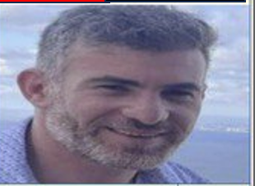
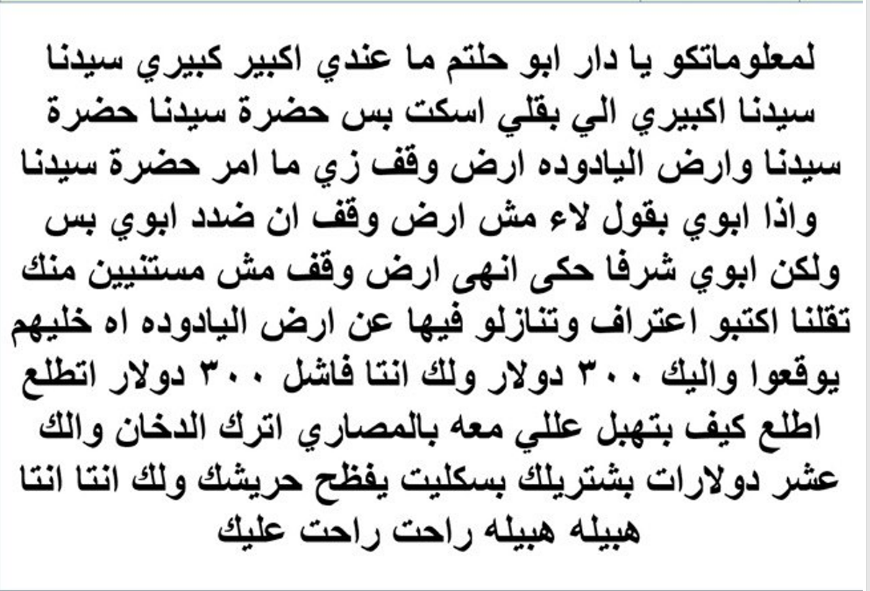
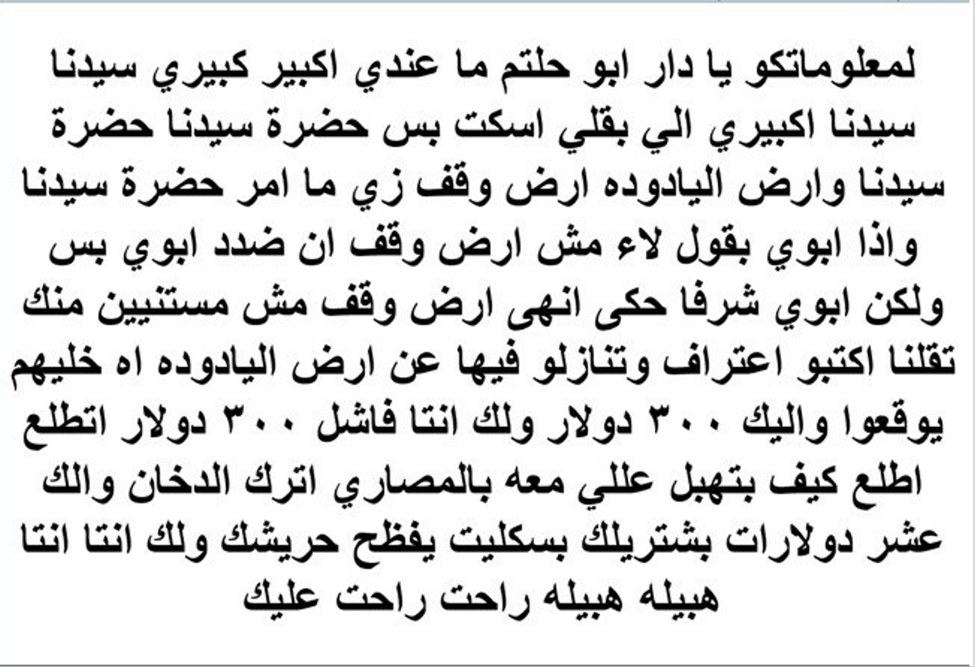
File#
68
Date and time of record
لسماع الصوت بالعريبه اضغط هنا
For your information family of Abu Haltam. I have no master. I have only one master which is seedna (spiritual leader). Our spiritual leader our spiritual leader, the land of yadoodue is the land of god as hadrat seedna ordered. And even if my father says it is not the land of waqf(land of Allah) I am against my father. I am against my father. But my father honor he just say it’s the land of waqf.
We are not wating for you to come and tell us write a confession and give up the land. We are not waiting for you to give away yadoodeh and you say lethim sign what you are saying and you say let me give you 300. you are a loser. 300 dollars look at how he makes fun of himself. And he needs to show that he has money, he says quit smoking I will give you $10, may God humiliate you, you are stupid stupid stupid. You are lost.
ولمعلوماتكوا يا دار ابو حلتم انا ما عندي اكبير كبيري سيدنا حضرة سيدنا اكبيري الي بقلي اسكت بس حضرة سيدنا حضرة سيدنا وارض اليادوده ارض وقف زي ما امر حضرة سيدنا واذا ابوي بقول لاء مش ارض وقف انا ضد ابوي انا ضد ابوي بس ولكن ابوي شرفا حكي انها ارض وقف مش مستنيين منك تيجي تقلنا اييه اكتب اعتراف وتنازلوا فيها عن ارض اليادوده اه خليهم يوقعوا والك ثلاث مائه دولار والك انتا فاشل ثلاث مائه دولار اطلع اطلع كيف بتهبل على الي معوا بالمصاري اترك الدخان والك عشر دولارات اييه بشتريلك بسكليت يفظح حريشك ولك انتا انتا هبيله هبيله هبيله راحت عليك

Slide 69
File#
69
Date and time of record
لسماع الصوت بالعريبه اضغط هنا
And we would love to tell you good news we have follower in Jordan and we have follower in Palestine. People love and respect us and they wish to provide for us any service. *(they make the job done). Because we are help him on Saturday and Sunday. And we provided for many people. And people tell us please give us anything to do for you. Our friends are many, we know many people to get the job done. And our supporters are too many. And when we say something it crowd and big. And I will see who will stand with you from all dawaymeh. If the son of sidi Abdullah want to stand with you we are strong enough to stand in front of him children of Abdullah nassar.
وبنحب انبشرك كمان عنا ارجال في الاردن وعنا ارجال في فلسطين والناس بتحبنا وبتحترمنا وبتتمنى انها تخدمنا خدمه لانا احنا مقدمين السبت والاحد مقدمين لناس اكثير والناس بتقلك خدمه مشان الله اصحابنا اكثار ومعارفنا اكثار وعزوتنا اكثيره وفزعتنا اكبيره وبدي اشوف مين بدو يوقف معاك من الدوايمه كلياتها اذا اولاد سيدي عبد الله نصار بدهم يقفوا معك تعال جيبهم حياهم الله احنا قدها قدها وقدود يا ولاد عبد الله نصار

